Slide 1
Curriculum Vitae
How to write a CV

Slide 2
Content
What is CV?
Importance of CV
Format of CV
Steps of CV Writing
Example of CV

Slide 3
What is CV?
CV is the short form of the words “ curriculum vitae.”
It’s been derived from a Latin phrase which means “course of life.”
It is a detailed document which contains academic as well as professional history of a candidates.

Slide 4
Importance of CV
CV is considered as the most important document of a candidate. Because of its importance in professional career, it is necessary to structure it carefully. It is based on academic and professional credentials. It should be designed in such a way that it shown an employee’s experiences and accomplishments in attractive way.

Slide 5
Format of CV Writing All CVs contain basic information's and specific background of an employee. So, all CVs contain following format:
Name along with the address and contact
Educational Details
Skills
Work Experience
Hobbies and Interest

Slide 6
Steps of CV Writing
CV should be designed carefully because it portrays the whole personality of a candidate. It shows how serious and dedicated you are. So, CV making process can be done effectively if we follow the important steps of CV writing given as:
CV Template
Contact Information
Academic History
Professional Experience
Skills
Awards & Honors

Slide 7
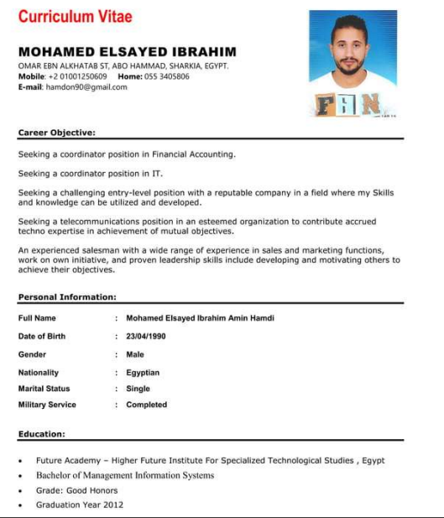
.

Slide 8
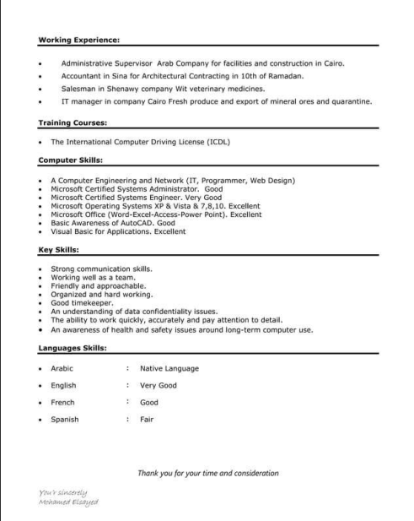
.

Slide 9
Thank you for attention

